Slide 1
“FRAUD DETECTION”

Slide 2
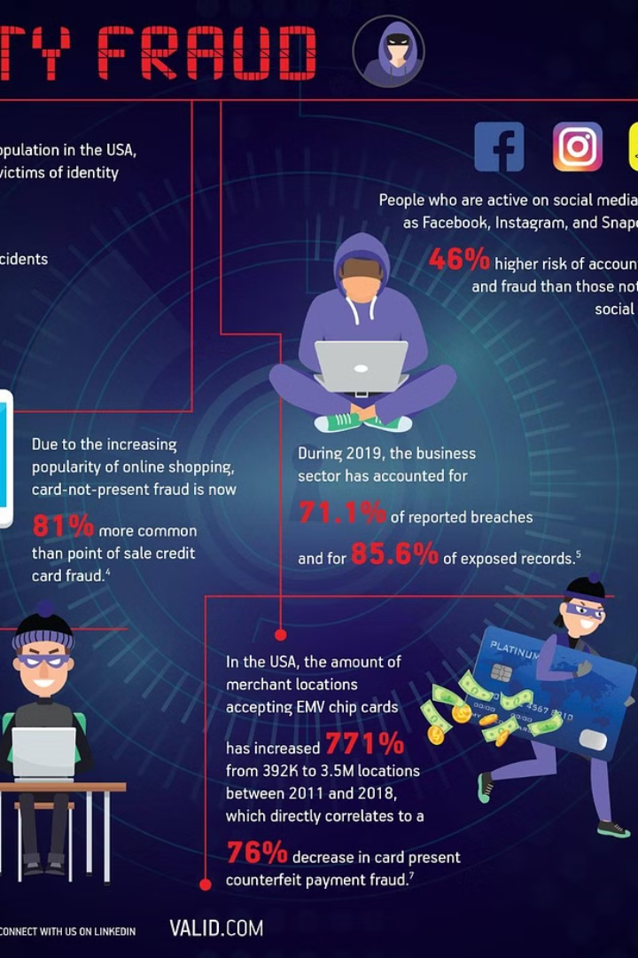
Introduction to Fraud Detection and Prevention
In today's digital age, spam emails have become a pervasive nuisance. These unsolicited and irrelevant messages bombard users' inboxes, negatively impacting:
Productivity: Time wasted sorting through and deleting spam emails can significantly hinder workflow efficiency.
Security: Phishing attempts disguised as legitimate emails can trick users into revealing sensitive information or clicking malicious links leading to malware infection.
User Experience: The constant influx of irrelevant emails can be frustrating and disrupt workflow, leading to a negative user experience.
Traditional spam filters rely on static rules like blacklists of known spam sender addresses and keyword matching. However, these filters have limitations:
Easily Bypassed: Spammers can continuously change sender addresses and adapt content to bypass keyword filters.
False Positives/Negatives: Legitimate emails might be flagged due to keyword overlap, while cleverly crafted spam emails might slip through.
Natural Language Processing (NLP) to the Rescue
NLP offers a powerful approach to analyze email content for more effective spam detection. NLP techniques can extract valuable insights from text data, allowing the system to understand the context and intent behind the email.

Slide 3

PROPOSED PROBLEM
The ever-increasing volume of spam emails poses a significant challenge for users and email service providers. Traditional spam filters based on blacklists and keyword matching are becoming increasingly ineffective due to spammers' ability to continuously adapt their tactics. This leads to:
Reduced User Productivity: Users waste time sorting through and deleting spam, hindering their workflow efficiency.
Security Risks: Phishing attempts disguised as legitimate emails can trick users into revealing sensitive information or clicking malicious links, potentially compromising their security.
Negative User Experience: The constant influx of irrelevant emails disrupts workflow and creates a frustrating user experience.
Therefore, we need a more sophisticated and robust spam detection system that can address these limitations. This project aims to develop a system that utilizes Natural Language Processing (NLP) techniques and a Convolutional Neural Network (CNN) to achieve the following objectives:
Enhanced Spam Detection Accuracy: Significantly improve the accuracy of spam detection compared to traditional filters by leveraging the power of NLP and CNN for deeper content analysis.
Automated Spam Detection: Automate the spam detection process, eliminating the need for manual intervention and ensuring consistent filtering.
Improved User Experience: Streamline email management by efficiently filtering out spam, allowing users to focus on legitimate emails and increase their productivity.

Slide 4
OBJECTIVES OF THE PROPOSED WORK
1. Data Acquisition and Preprocessing:
We will utilize publicly available datasets like the Spam Assassin Public Corpus or UCI Spam base Dataset. These datasets contain labeled email messages categorized as spam or non-spam (ham).
Alternatively, consider collecting your own data with user consent, ensuring anonymity and ethical data handling practices. This can potentially capture more relevant spam patterns specific to your environment.
Data Preprocessing Steps:
Load the dataset using libraries like pandas.
Extract the email text from the designated column.
Clean the text using NLP techniques:
Lowercase conversion
Removal of leading/trailing whitespaces
Removal of special characters (except spaces)
Tokenization (splitting text into words/phrases)
Removal of stop words (common words like "the", "a", "an")
Optional: Stemming/lemmatization (reducing words to their root form)
Split the data into features (text) and labels (spam/not spam) based on the designated columns.

Slide 5
2. Model Development (CNN Architecture):
The proposed system employs a CNN architecture for spam detection:
Embedding Layer: This layer converts the preprocessed text (represented as sequences of words) into dense numerical vectors with a specified dimensionality. This allows the model to learn semantic relationships between words.
Convolutional Layers: These layers extract local features from the sequence of word vectors. They apply filters that slide across the sequence, capturing patterns within a specific window size. Multiple filters can be used to identify different types of features indicative of spam.
Max Pooling Layers: These layers down sample the output from the convolutional layers by selecting the most significant feature from a specific window size. This reduces model complexity and helps capture dominant features.
Flatten Layer: This layer transforms the two-dimensional output from the convolutional layers into a one-dimensional vector suitable for feeding into the fully connected layers.
Dense Layers: These fully connected layers further process the features extracted by the convolutional layers. They use non-linear activation functions like ReLU to learn complex relationships between the features and the spam classification.
Output Layer: This layer typically consists of a single neuron with a sigmoid activation function. The sigmoid function outputs a value between 0 and 1, representing the probability of an email being spam (closer to 1) or not spam (closer to 0).

Slide 6
3. Model Training and Evaluation:
The preprocessed email data and corresponding labels (spam/not spam) will be used to train the CNN model.
During training, the model adjusts the weights and biases of its layers to minimize the loss function (e.g., binary cross-entropy for spam classification) and improve its ability to distinguish between spam and non-spam emails.
Metrics like accuracy, precision, recall, and F1-score will be used to evaluate the model's performance on a separate validation set.
Techniques like hyperparameter tuning can be employed to optimize the model's performance.
4. API Integration (Optional):
Once trained and evaluated, the model can be integrated into a web API framework like Flask or Django. This allows other applications or services to interact with the spam detection system programmatically.
The API can expose an endpoint that accepts an email message as input (text or raw email format) and returns a JSON response with the predicted spam probability (between 0 and 1).
This API can be leveraged by email clients, web applications, or other services to perform real-time spam detection and filtering.
5. Deployment and User Interface (Optional):
The trained model (with or without API integration) can be deployed as part of an email service provider's infrastructure for real-time spam detection.
A user interface could be developed to allow users to view the spam detection results and potentially customize filtering parameters based on their preferences.

Slide 7
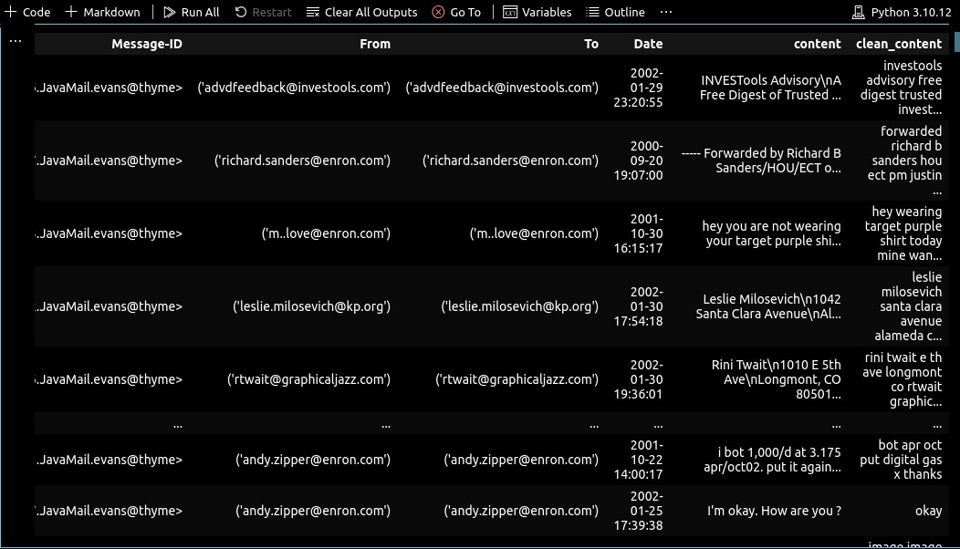
PROPOSED SYSTEM
Step 1: Data Acquisition and Preprocessing
1. Dataset:
Utilize a publicly available dataset like the Spam Assassin Public Corpus ([https://spamassassin.apache.org/old/publiccorpus/](https://spamassassin.apache.org/old/publiccorpus/)) containing labeled email messages (spam/not spam).
Alternatively, consider collecting your own data with user consent, ensuring anonymity and ethical data handling practices (potentially capturing more relevant spam patterns specific to your environment).

Slide 8
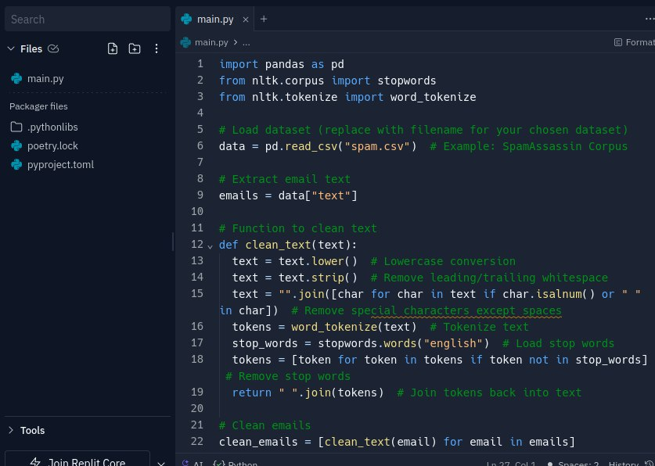
2. Code (Python with pandas and NLTK):
This code snippet:
Loads the dataset using pandas.
Extracts email text from the designated column.
Performs basic text cleaning steps: Lowercase conversion, whitespace removal, special character removal (except spaces), tokenization, and stop word removal.
Splits the data into features (`X` - cleaned text) and labels (`y` - spam/not spam).

Slide 9
Step 2: Model Development (CNN Architecture)
1. Model Architecture:
The system utilizes a Convolutional Neural Network (CNN) to capture sequential patterns within email text for spam detection. Here's the architecture breakdown:
1. Embedding Layer: Converts text sequences into dense numerical vectors.
2. Convolutional Layers: Extract local features from the sequence of word vectors using filters that slide across the sequence.
3. Max Pooling Layers: Downsample the output from the convolutional layers, selecting the most significant feature from a window size.
4. Flatten Layer: Transforms the two-dimensional output from the convolutional layers into a one-dimensional vector suitable for feeding into the fully connected layers.
5. Dense Layers: Further process the extracted features using non-linear activation functions like ReLU.
6. Output Layer: Single neuron with a sigmoid activation function, producing a probability of an email being spam (between 0 and 1).

Slide 10
DEEP LEARNING APPLICATIONS
Deep learning applications in NLP, including
and
, have revolutionized fraud
detection by enabling the extraction systems.

Slide 11

CASE STUDIES
Exploring real-world case studies of NLP fraud detection implementations provides valuable insights into the eﬀectiveness of these techniques. By examining successful fraud detection scenarios, we can gain a deeper understanding of the practical applications and benefits of NLP in combating deception.

Slide 12

ETHICAL CONSIDERATIONS
As we delve into the realm of NLP fraud detection, it's crucial to address the ethical considerations surrounding the use of these technologies. Balancing privacy, transparency, and accountability is essential in leveraging NLP for fraud detection while upholding ethical standards.

Slide 13

REGULATORY COMPLIANCE
Navigating the regulatory landscape is paramount in implementing NLP fraud detection solutions. Understanding the legal frameworks, data privacy regulations, and compliance requirements ensures that NLP applications adhere to industry standards and regulatory guidelines.

Slide 14




FUTURE TRENDS
Exploring the future trends in NLP fraud detection unveils the potential advancements and innovations in this field. From enhanced
to , the future
of NLP holds promising developments that will further strengthen fraud detection capabilities.

Slide 15

INDUSTRY IMPACT
The impact of NLP fraud detection extends across diverse industries, including finance, healthcare, e-commerce, and beyond.
Understanding how NLP technologies can safeguard businesses and consumers from fraudulent activities highlights the significant
role of NLP in ensuring trust and security.

Slide 16

CHALLENGES AND OPPORTUNITIES
Addressing the challenges and opportunities in NLP fraud detection provides valuable insights into the evolving landscape of deceptive practices and the potential for innovative solutions. By recognizing these dynamics, organizations can proactively adapt and enhance their fraud detection strategies.

Slide 17

IMPLEMENTATION STRATEGIES
Eﬀective implementation strategies for NLP fraud detection encompass data integration, model training, and continuous monitoring. By integrating NLP technologies into existing fraud detection frameworks, organizations can strengthen their defenses against deceptive practices.

Slide 18
CONCLUSION
In conclusion, NLP fraud detection serves as a powerful tool in unveiling deception and safeguarding against fraudulent activities. By harnessing the capabilities of NLP, organizations can enhance their fraud detection capabilities, protect consumer trust, and mitigate the impact of deceptive practices.

Slide 19

Thanks!
Do you have any questions?
youremail@freepik.com
+34 654 321 432
yourwebsite.com

